Slide 1
CAPSTONE PROJECT Project Name : Driver drowsiness system Review-2 & 3
GUIDE : Nagendra Panini Challa
Project Members:
19BCD7143-Amlan Shivam Nayak
19BCD7076-Mani Shankar Rohith
19BCD7183-Vidya Sagar Karuturi

Slide 2
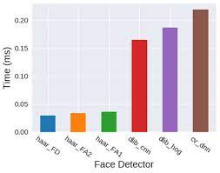
Results

Slide 3
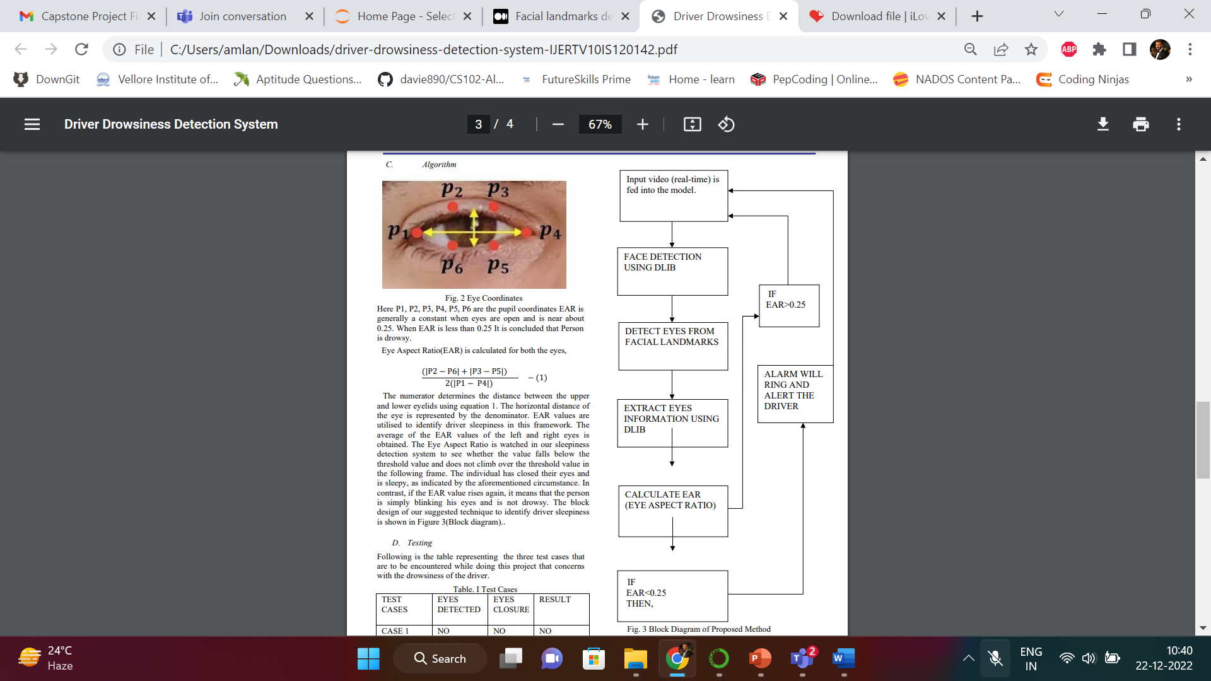

Slide 4
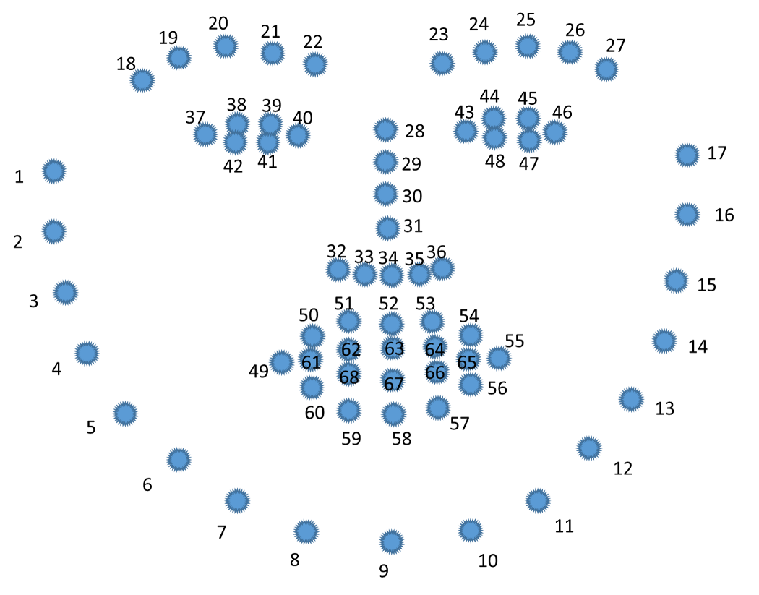

Slide 5
Accuracy
Serial No. | Eye Detection Accuracy | Drowsiness Accuracy
Sample1 | 86.3% | 83.34%
Sample2 | 83.9% | 73.5%
Sample3 | 79.1% | 81.7%
Sample4 | 79.1% | 78.67%
Sample5 | 91.7% | 100%
TOTAL | 84.02% | 83.442%

Slide 6
For this venture we utilized a webcam associated with the laptop. Inbuilt speaker in the system is utilized to deliver sound output to awaken the driver when drowsiness is detected.
The framework was tried for different individuals in various surrounding lighting conditions (daytime and evening time).
Eye Detection Accuracy= total no. of times eyes detected /(total no. of times eyes detected+ total no. of times eyes not detected).
Drowsiness Detection Accuracy= total no. of times alarm sounds/ (total no. of times alarm sounds +total no of times alarm didn’t sound).
Every individual who volunteered for the test will be approached to squint multiple times and act sluggish multiple times amid the test procedure.

Slide 7
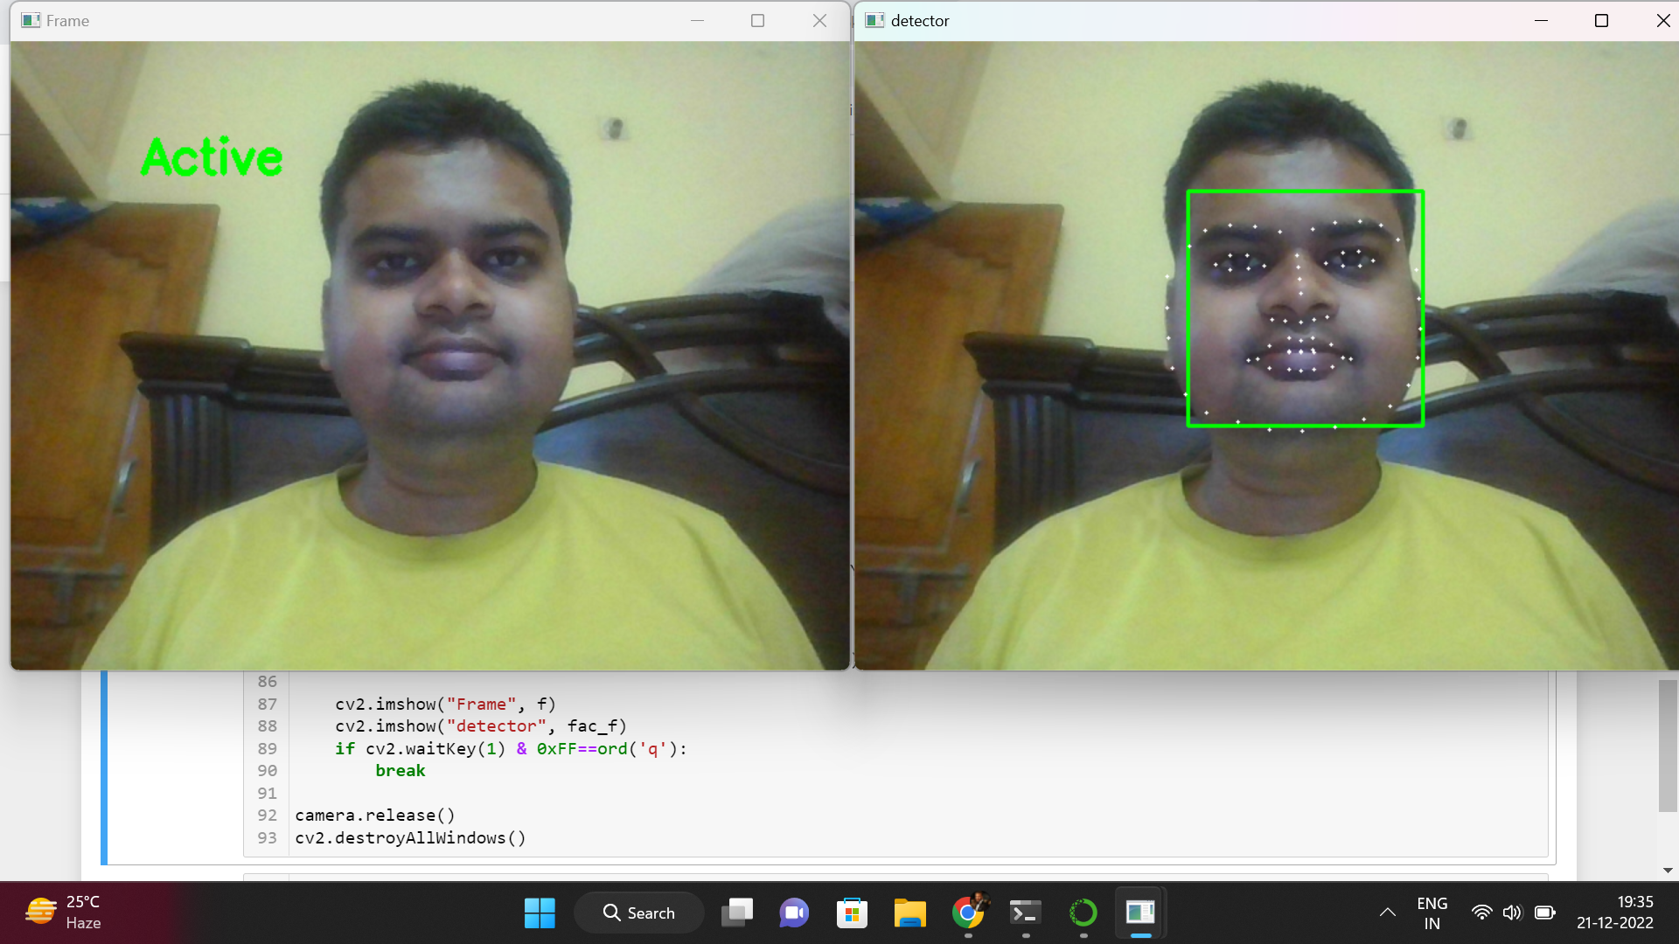
Outputs

Slide 8
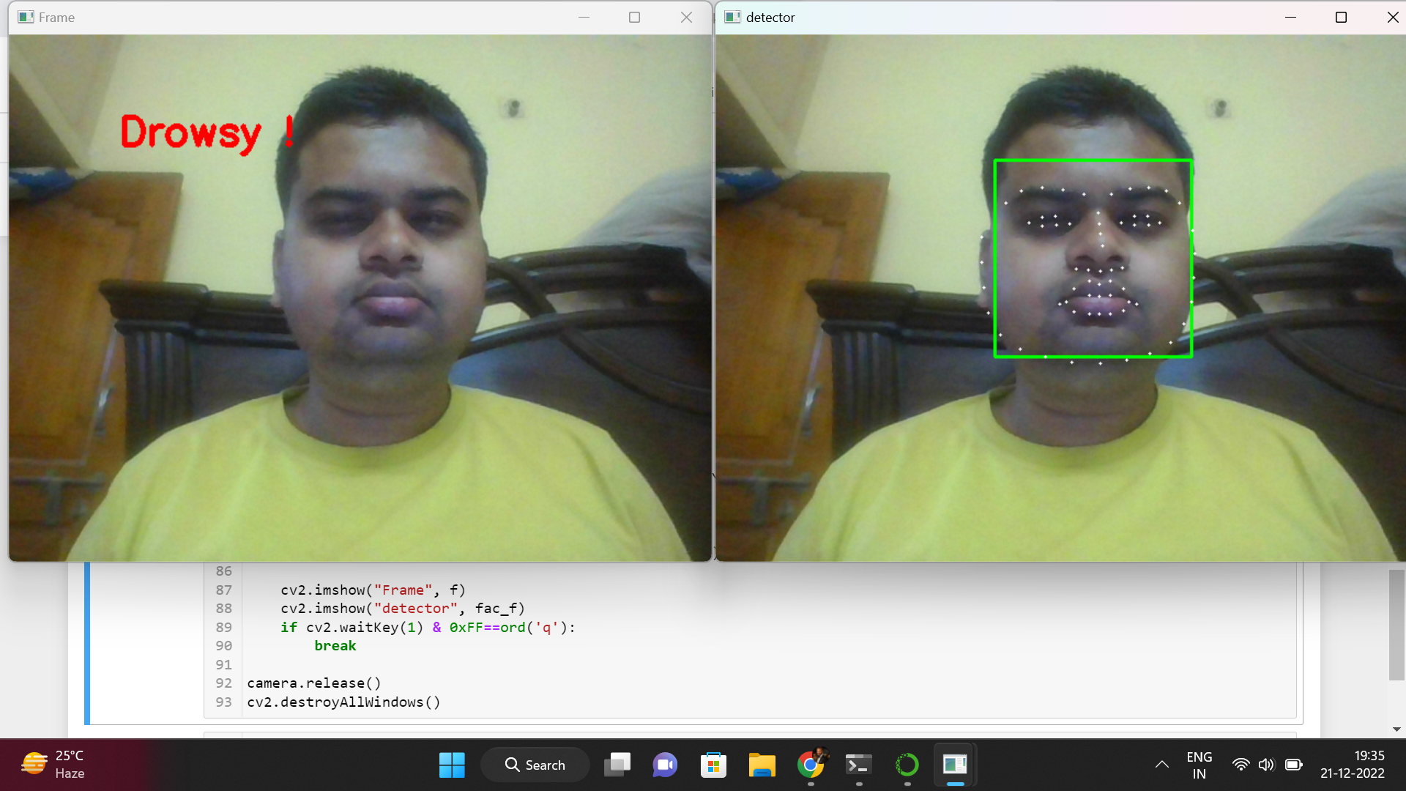

Slide 9
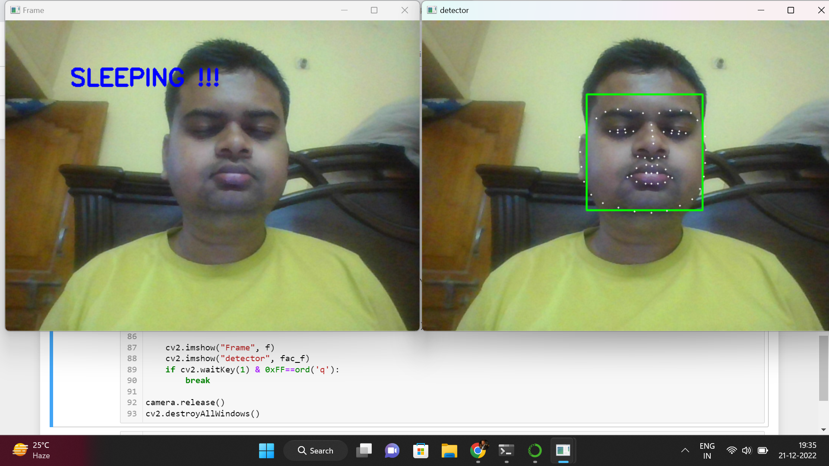

Slide 10
Objectives Met
This intermediate Python project's goal was to create a sleepiness detection system that can recognise when someone's eyes are closed for a brief period of time.So this was achieved.
When the program is executed,it accurately detects the status of eyes quickly which performs better than other algorithms as shown in graphs page.
The average real-time test accuracies obtained using Dlib for Eye Detection Accuracy was found to be 84.02% and Drowsiness Accuracy as found to be 83.442%.

Slide 11
Methodology
Eyeblink measurement:
A camera records the driver’s face and checks if the driver’s eyes are closed or open. The estimated average blinking duration is between 100-400ms according to the Harward database of useful biological numbers.
If the camera sees that the eye of the driver closes for a duration far more than that it marks the driver as asleep and some sort of alarm raised.
This method has proven to be the most effective measure and easiest to implement providing satisfactory results.

Slide 12
The suggested method for detecting tiredness in drivers operates on two levels. The procedure begins with the camera recording live video frames, which are then transferred to a local server.
The Dlib library is utilised on the server to identify facial landmarks, and a threshold value is used to determine whether or not the driver is sleepy. The EAR (Eye Aspect Ratio) is then computed using these face landmarks and given to the driver.
The EAR value obtained at the application's end is compared to a threshold value of 0.25 in our system.
The driver is regarded to be sleepy if the EAR value is less than the threshold value. An alarm would then sound, alerting the driver and passengers.
A. Components:
For drowsiness detection we have used OpenCV and Python.The Dlib library is used to detect and isolate the facial landmarks using Dlib pre-trained facial landmark detector. In this approach, 68 facial landmarks have been used.

Slide 13
B. Facial landmark marking:
Dlib library is imported and used for the extraction of facial landmarks. Dlib uses a pre-trained face detector, that is an improvement of the histogram of oriented gradients . It consists of two shape predictor models trained on the i-Bug 300-W dataset, that each localize 68 and 5 landmark points respectively within a face image. In this approach, 68 facial landmarks have been used.
In this method, frequencies of gradient direction of an image in localized regions are used to form histograms. It is especially suitable for face detection; it can describe contour and edge features exceptionally in various objects.
For recording the Facial Landmarks ,the Facial Landmark Predictor was used by the system to calculate lengths for the EAR values

Slide 14
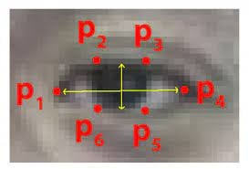
Here P1, P2, P3, P4, P5, P6 are the pupil coordinates EAR is generally a constant when eyes are open and is near about 0.25. When EAR is less than 0.25 It is concluded that Person is drowsy. Eye Aspect Ratio(EAR) is calculated for both the eyes,
(|P2 − P6| + |P3 − P5|) /2(|P1 − P4|)
The numerator determines the distance between the upper and lower eyelids using equation 1. The horizontal distance of the eye is represented by the denominator. EAR values are utilised to identify driver sleepiness in this framework. The average of the EAR values of the left and right eyes is obtained. The Eye Aspect Ratio is watched in our sleepiness detection system to see whether the value falls below the threshold value and does not climb over the threshold value.The individual has closed their eyes and is sleepy, as indicated by the aforementioned circumstance.
In contrast, if the EAR value rises again, it means that the person is simply blinking his eyes and is not drowsy.

Slide 15
Applications
This system can be used in factories to alert the workers.
If found drowsy, the alarm system gets activated and the driver is alerted.
If there is any obstacles it is alerted to the driver.
This system can also be used for railway drivers.
Can be implemented in other projects like computer vision, self-driving cars, drive safety, etc.
Driver drowsiness project can be used with a raspberry pie to create a standalone system for drivers, used as a web service, or installed in workplaces to monitor employees’ activity. The sensitivity and the number of frames can be changed according to the requirements.

Slide 16
Tools Used
Webcam
Python
Libraries used:
Opencv
Dlib
Numpy
Pygame
shape_predictor_68_face_landmarks.dat (Dataset)

Slide 17
Conclusion
The drowsiness detection system is capable of detecting drowsiness in quickly. The system which can differentiate normal eye blink and drowsiness can prevent the driver from entering the state of sleepiness while driving. During the monitoring, the system is able to decide if the eyes are closed or opened. When the eyes have been closed for too long a warning signal is issued.
The ultimate goal of the system is to check the drowsiness condition of the driver. Based on the eye movements of the driver, the drowsiness is detected and according to eye blink, the alarm will be generated to alert the driver. By doing this, many accidents will be reduced and provides safety to the driver and vehicle.
A system that is driver safety and car security is presented only in luxurious costly cars. Using eye detection, driver security and safety can be implemented in normal car also.

